Slide 1
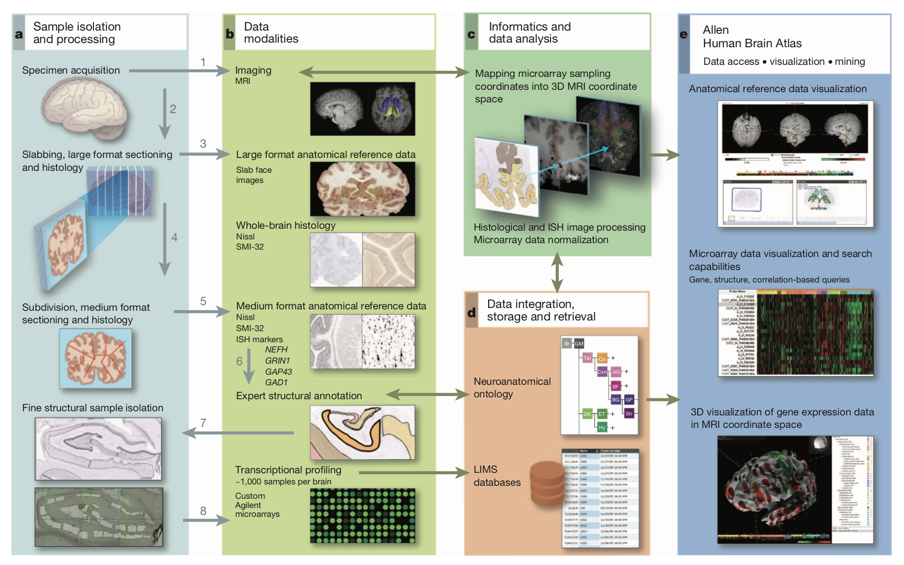
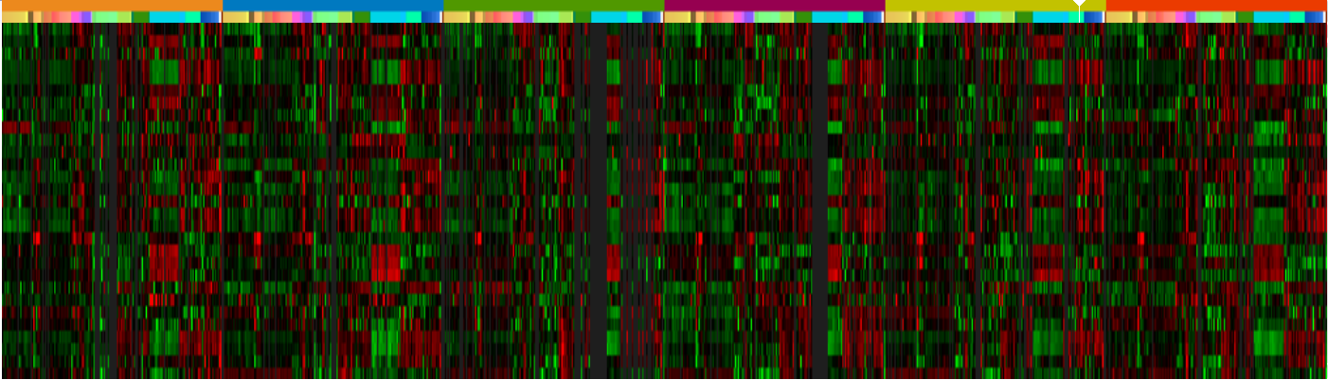
Computational Analysis of Stress/HPA axis
Vinisha Venugopal, Steven Stover, William Scott, Tracy Okonyo
Arizona State University
Abstract
Methodology
Results
Conclusion
Psychological stress affects the brain functions and also has an influence on structural changes throughout the lifespan incase of severe level. Stress causes disturbances in brain and are believed to necessitate depression and other mental disorders. With the help of DNA microarray, the gene expression of human brain was analyzed. The stress duration has an impact on the gene expressions and certain genes are highly expressed during stress. HPA axis plays an important role during stress and therefore genes related to hypothalamus and pituitary gland are analyzed. The genes like “” related to HPA are found to be highly expressed
The data was accessible in Allen Data Atlas, the main aim of Allen Data Atlas is to create a comprehensive map of the transcript usage across the brain area.
Add your information, graphs, and images to this section.
Add your information, graphs, and images to this section.
Introduction
Stressors cause stimulation of the hypothalamus which then leads to stimulation of the pituitary gland. The pituitary gland releases adrenocorticotropic hormone which causes the adrenal gland to release cortisol. Cortisol has many functions during the stress response including control of glucose release, which can be used for energy.
Acknowledgements
Add your information, graphs, and images to this section.

